Slide 1
Sprint 5
Refactor

Slide 2
Sprint 5 – Refactor()
Product Owner – Gabe
Scrum Master – Michael
Development Team – Gabe, Michael, Billy, Dane, Chris

Slide 3
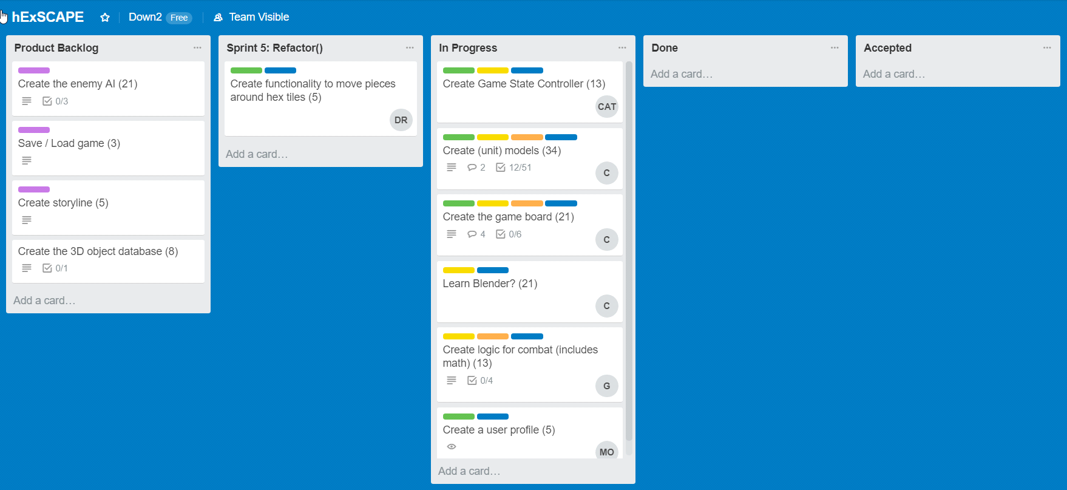
Sprint 5 Trello Snapshot

Slide 4
Dane’s Sprint 5 Goals
Enable basic movement around the board
Planning to invest 8 hours toward this goals

Slide 5
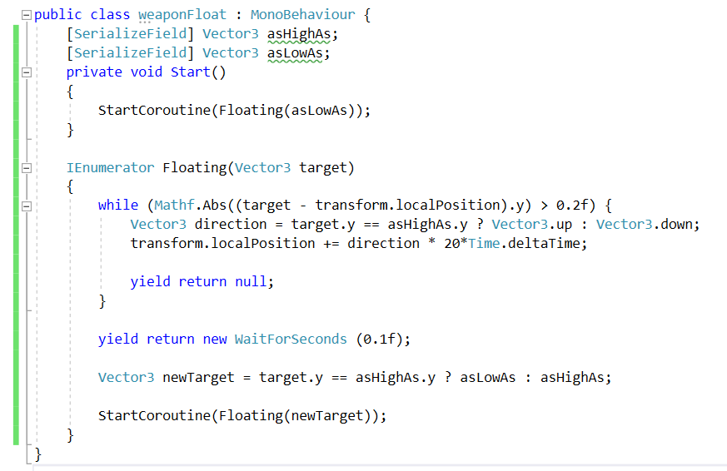
Dane’s Sprint 5 Accomplishments
Learned about IEnumerators with the “yield” command

Slide 6
Dane’s Sprint 5 Accomplishments
*Completed 11 hours of work to achieve these goals
Integrated Billy’s board with my code
Used Billy’s models and co-routines to make a weapon float above the board
Spawned pieces on the board (and they aren’t just cubes anymore folks!)
After 2 sprints, can finally move the pieces around the board

Slide 7
Michael’s Sprint 5 Goals
Create User Profile options for the main menu.
I planned to commit about 5 hours.

Slide 8
Accomplishments
Profile completion forms and profile view form GUI’s are completed.
  GUI forms pop up in the profile select menu.
  Forms will return to a null status after they are completed.
Wrote scripts to create and write files for each profile that contain basic information that is filled out on the form.
  The data is simple. The data includes a name for the profile and the user’s selected class.
Total amount of time spent this week on this task was about six hours.
There are no reading capabilities for the menu to change as profiles are created yet.

Slide 9
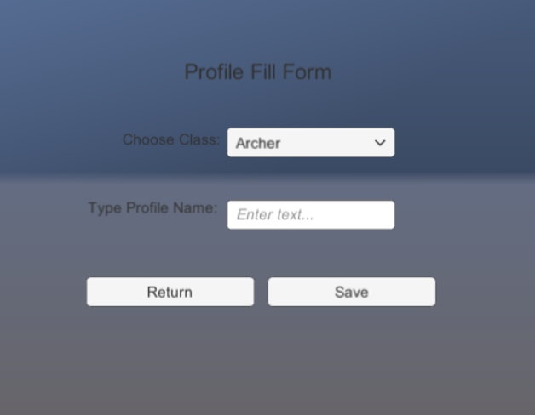
Profile Form Screenshot

Slide 10
Billy's Goals
Work on animations in Blender
Continue making models
Create an intro for the game

Slide 11
Accomplishments
See video... 1 hour for the software to compile a 5 second animation (lesson learned)
Town Plot – 2 hours to create

